Slide 1


Smart Banking Application: Transaction and Recovery Protocols
This project file details the "Smart Banking Application Implementing Transaction and Recovery Protocols," developed for the Advance Database Management System course. It showcases real-world banking functionalities and advanced DBMS concepts.
Submitted by Sankalp Gupta (B.TECH CSE(AI) 3rd YEAR 2K22) to Dr. Deepak Verma.

Slide 2

Project Overview: Bank Management System
The Bank Management System is a web-based application simulating real-world banking functionalities like money transfer and account management. It's a capstone project for the Advance Database Management System (CSE-S511) course, focusing on ensuring data consistency, atomicity, isolation, and durability (ACID properties).
The system uses MySQL for database management, Flask for the backend, and HTML/CSS for a user-friendly frontend. Key features include safe, atomic money transfers, automatic transaction logging, and rollback on failure, demonstrating practical application of advanced DBMS concepts.

Slide 3

Key Objectives of the Project
1
Simulate Banking Operations
Replicate real-world fund transfers between customer accounts using structured database procedures.
2
Implement ACID Properties
Ensure atomicity, consistency, isolation, and durability in all transaction processing.
3
Utilise Stored Procedures & Logging
Manage and track each transaction for reliability and recoverability.
4
Apply Concurrency Control
Prevent issues like dirty reads, lost updates, and deadlocks during simultaneous operations.

Slide 4
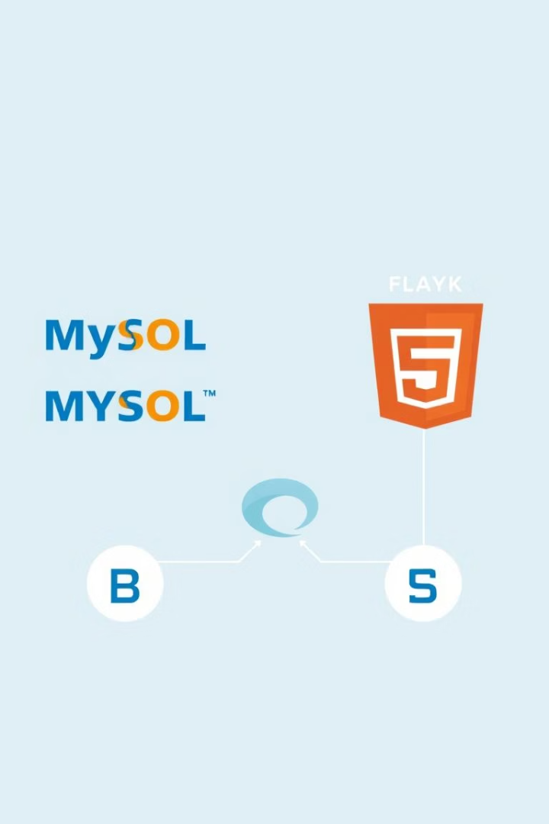



Technologies Utilised
MySQL
Flask (Python)
HTML/CSS
Used as the backend relational database for storing and managing account and transaction data, supporting stored procedures, logging, and concurrency control.
A lightweight Python web framework for creating the frontend interface, handling HTTP requests, and connecting the user interface with the MySQL database.
HTML structures the web pages, while CSS styles them, including layout, background images, tables, and input forms, ensuring a user-friendly and visually appealing interface.

Slide 5
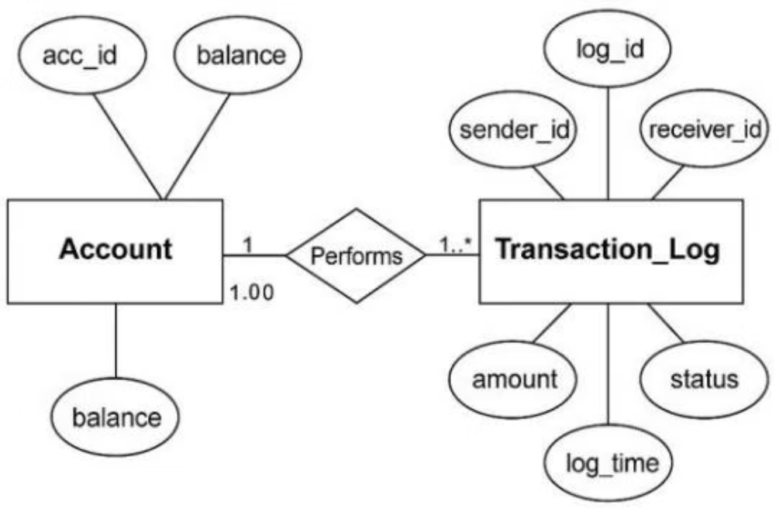
Database Design and Relationships
ER Diagram
Tables Used
The Entity-Relationship (ER) diagram logically structures the database, including entities like Account (acc_id, acc_name, balance) and Transaction_Log (log_id, sender_id, receiver_id, amount, status, log_time). It shows a one-to-many relationship between Account and Transaction_Log.
accounts: acc_id (PK), acc_name (VARCHAR), balance (DECIMAL)
transaction_log: log_id (PK, Auto Increment), sender_id (FK), receiver_id (FK), amount (DECIMAL), status (VARCHAR), log_time (TIMESTAMP)
Relationships
Each transaction references two accounts (sender and receiver). The transaction_log maintains foreign key relationships with the accounts table using sender_id and receiver_id, with cascading rules ensuring referential integrity.

Slide 6

Advanced DBMS Concepts Implemented
Transaction Management
Ensures ACID properties through stored procedures, with automatic rollback on failure using ROLLBACK and COMMIT.
Concurrency Control
Prevents issues like double spending by locking rows during balance updates, ensuring transaction serializability.
Recovery Techniques
Maintains a transaction_log table to record each transfer, enabling tracing for crash recovery and rollback.
Query Optimization & Indexing
Optimizes frequently used queries by selecting necessary columns and using ORDER BY. Primary and foreign keys, along with indexing, ensure faster lookups and retrieval.

Slide 7
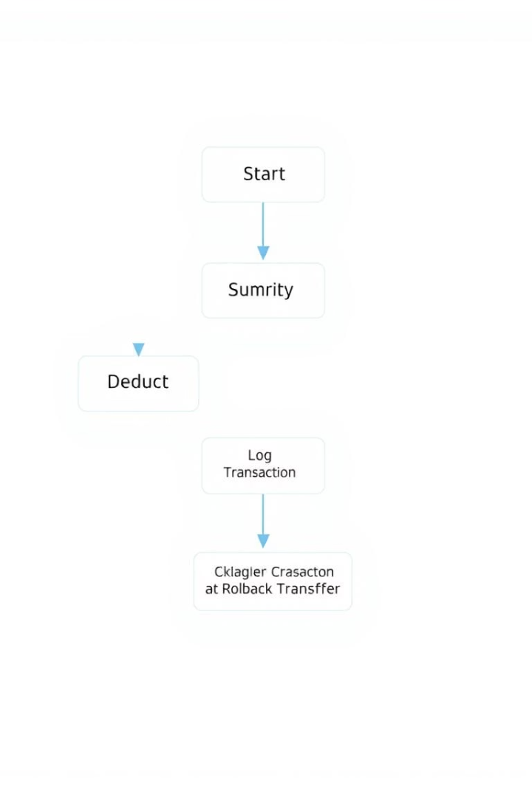




Implementation Details
Stored Procedure for Money Transfer
A MySQL stored procedure, 'transfer_money', checks sender balance, deducts amount, adds to receiver, logs the transaction, and returns status.
Safe Transaction Commit/Rollback
In Flask, 'cursor.callproc()' executes the procedure. 'db.commit()' is called on success, while 'db.rollback()' cancels transactions on error, preventing partial updates.
Displaying Transaction Logs
The application queries 'transaction_log' ordered by 'log_time DESC' to display all past transactions, ensuring transparency.
Balance Update Mechanism
Balances are securely updated within the stored procedure using atomic SQL UPDATE statements, preventing inconsistencies from concurrent access or page refreshes.

Slide 8

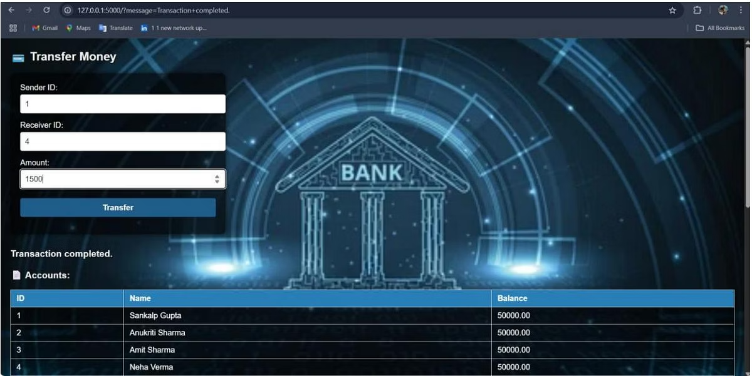
Testing and Validation
Test Case
Input (Sender → Receiver, Amount)
Expected Output
Actual Result
Status
TC1
1 → 2, ₹100
Amount transferred successfully
As expected
Pass
TC2
1 → 2, ₹0
Error: Invalid amount
Error shown
Pass
TC3
3 → 4, ₹5000 (Exceeds balance)
Error: Insufficient balance
Error shown
Pass
TC4
2 → 2, ₹100
Error: Sender and receiver same
Error shown
Pass
The system was rigorously tested with various sample test cases to ensure correct functionality and error handling. Edge cases like insufficient balance, negative/zero amounts, same sender/receiver, and page refreshes were specifically addressed to prevent inconsistencies and ensure robust transaction processing.

Slide 9

Conclusion and Future Scope
Conclusion
Future Scope
The Banking Transaction Management System successfully demonstrates key Advanced DBMS concepts including transaction processing, concurrency control, recovery, and indexing. The integration of MySQL procedures with Flask provided a reliable and testable banking simulation, complete with essential account and log tracking functionalities.
Implement an authentication system for user login security.
Introduce role-based access for admins and customers.
Develop detailed audit trails with enhanced logging and export features.
Improve UI/UX with a more responsive and modern frontend design.
Incorporate real-time updates using WebSockets or AJAX for transactions.

